Slide 1



Research Design & Statistics
Randomisation & (Generalised) Linear Models
Dr Frédérik Saltré
Global Ecology, Biological Science (213)
frederik.saltre@flinders.edu.au @FredSaltre

Slide 2

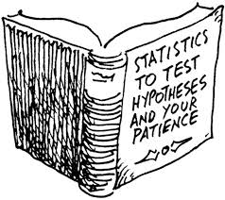

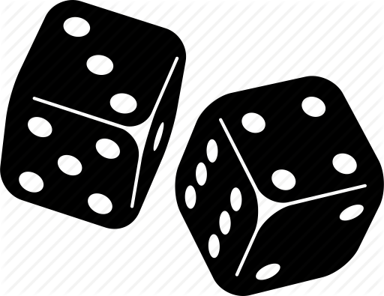


data analyses: randomisation
How to find way through the diversity of tests available?
many hypotheses regarded as alternatives to null (randomness)
randomisation = way of determining whether a given pattern is due purely to chance of observations in random order
applicable to all sorts of statistics
Research design & statistics in R

Slide 3
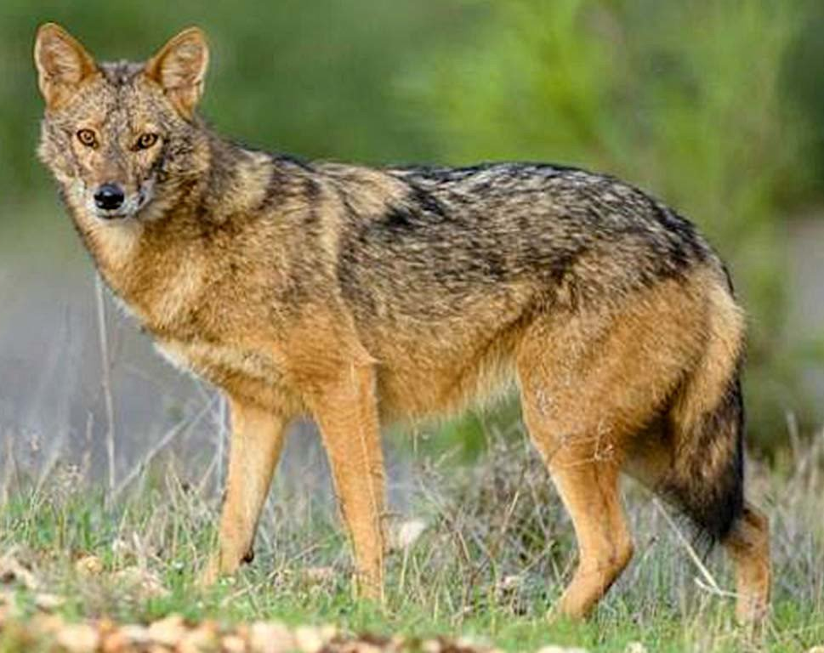
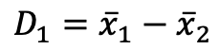
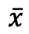
mandible lengths of male & female golden Jackals
males | 120 | 107 | 110 | 116 | 114 | 111 | 113 | 117 | 114 | 112
females | 110 | 111 | 107 | 108 | 110 | 105 | 107 | 106 | 111 | 111
mandible lengths in mm for male & female golden jackals (Canis aureus) – Higham et al (1980)
difference in mean length between sexes?
null hypothesis (H0) = any observed difference is due purely to chance
alternative hypothesis (H1) = males have higher mean
 |  | s
males | 113.4 | 3.72
females | 108.6 | 2.27
$$\overline{x}$$
$$D_{1}={\overline{x}}_{1}−{\overline{x}}_{2}$$
Research design & statistics in R

Slide 4
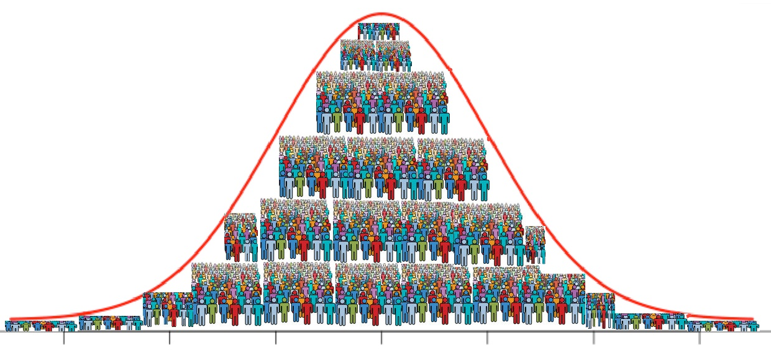

mandible lengths of male & female golden Jackals
males | 120 | 107 | 110 | 116 | 114 | 111 | 113 | 117 | 114 | 112
females | 110 | 111 | 107 | 108 | 110 | 105 | 107 | 106 | 111 | 111
mandible lengths in mm for male & female golden jackals (Canis aureus) – Higham et al (1980)
t-test is a conventional approach, but assumes:
random sampling of individuals from whole population
equal population standard deviations for males & females
normal distribution for mandible length scores within groups
Research design & statistics in R

Slide 5
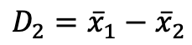
mandible lengths of male & female golden Jackals
males | 120 | 107 | 110 | 116 | 114 | 111 | 113 | 117 | 114 | 112
females | 110 | 111 | 107 | 108 | 110 | 105 | 107 | 106 | 111 | 111
mandible lengths in mm for male & female golden jackals (Canis aureus) – Higham et al (1980)
random reallocation of 20 lengths between two groups & recalculate new difference
males | 112 | 105 | 110 | 120 | 110 | 114 | 108 | 111 | 106 | 107
females | 116 | 114 | 111 | 110 | 111 | 111 | 117 | 107 | 107 | 113
$$D_{2}={\overline{x}}_{1}−{\overline{x}}_{2}$$
repeat process many time to obtain random distribution
Research design & statistics in R

Slide 6
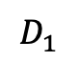
mandible lengths of male & female golden Jackals
males | 120 | 107 | 110 | 116 | 114 | 111 | 113 | 117 | 114 | 112
females | 110 | 111 | 107 | 108 | 110 | 105 | 107 | 106 | 111 | 111
mandible lengths in mm for male & female golden jackals (Canis aureus) – Higham et al (1980)
after 5000 randomisations
9 randomisations > D₁
9/5000 = 0.0018
prob = 0.0018 that difference between male & female purely due to chance
frequency
$$D_{1}$$
mean differences (male – female) in mm
Research design & statistics in R

